Slide 1
Lunar Lander Activity
Welcome _____School!

Slide 2
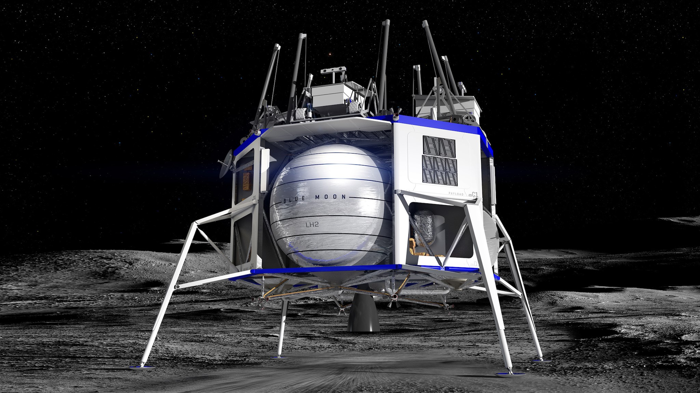
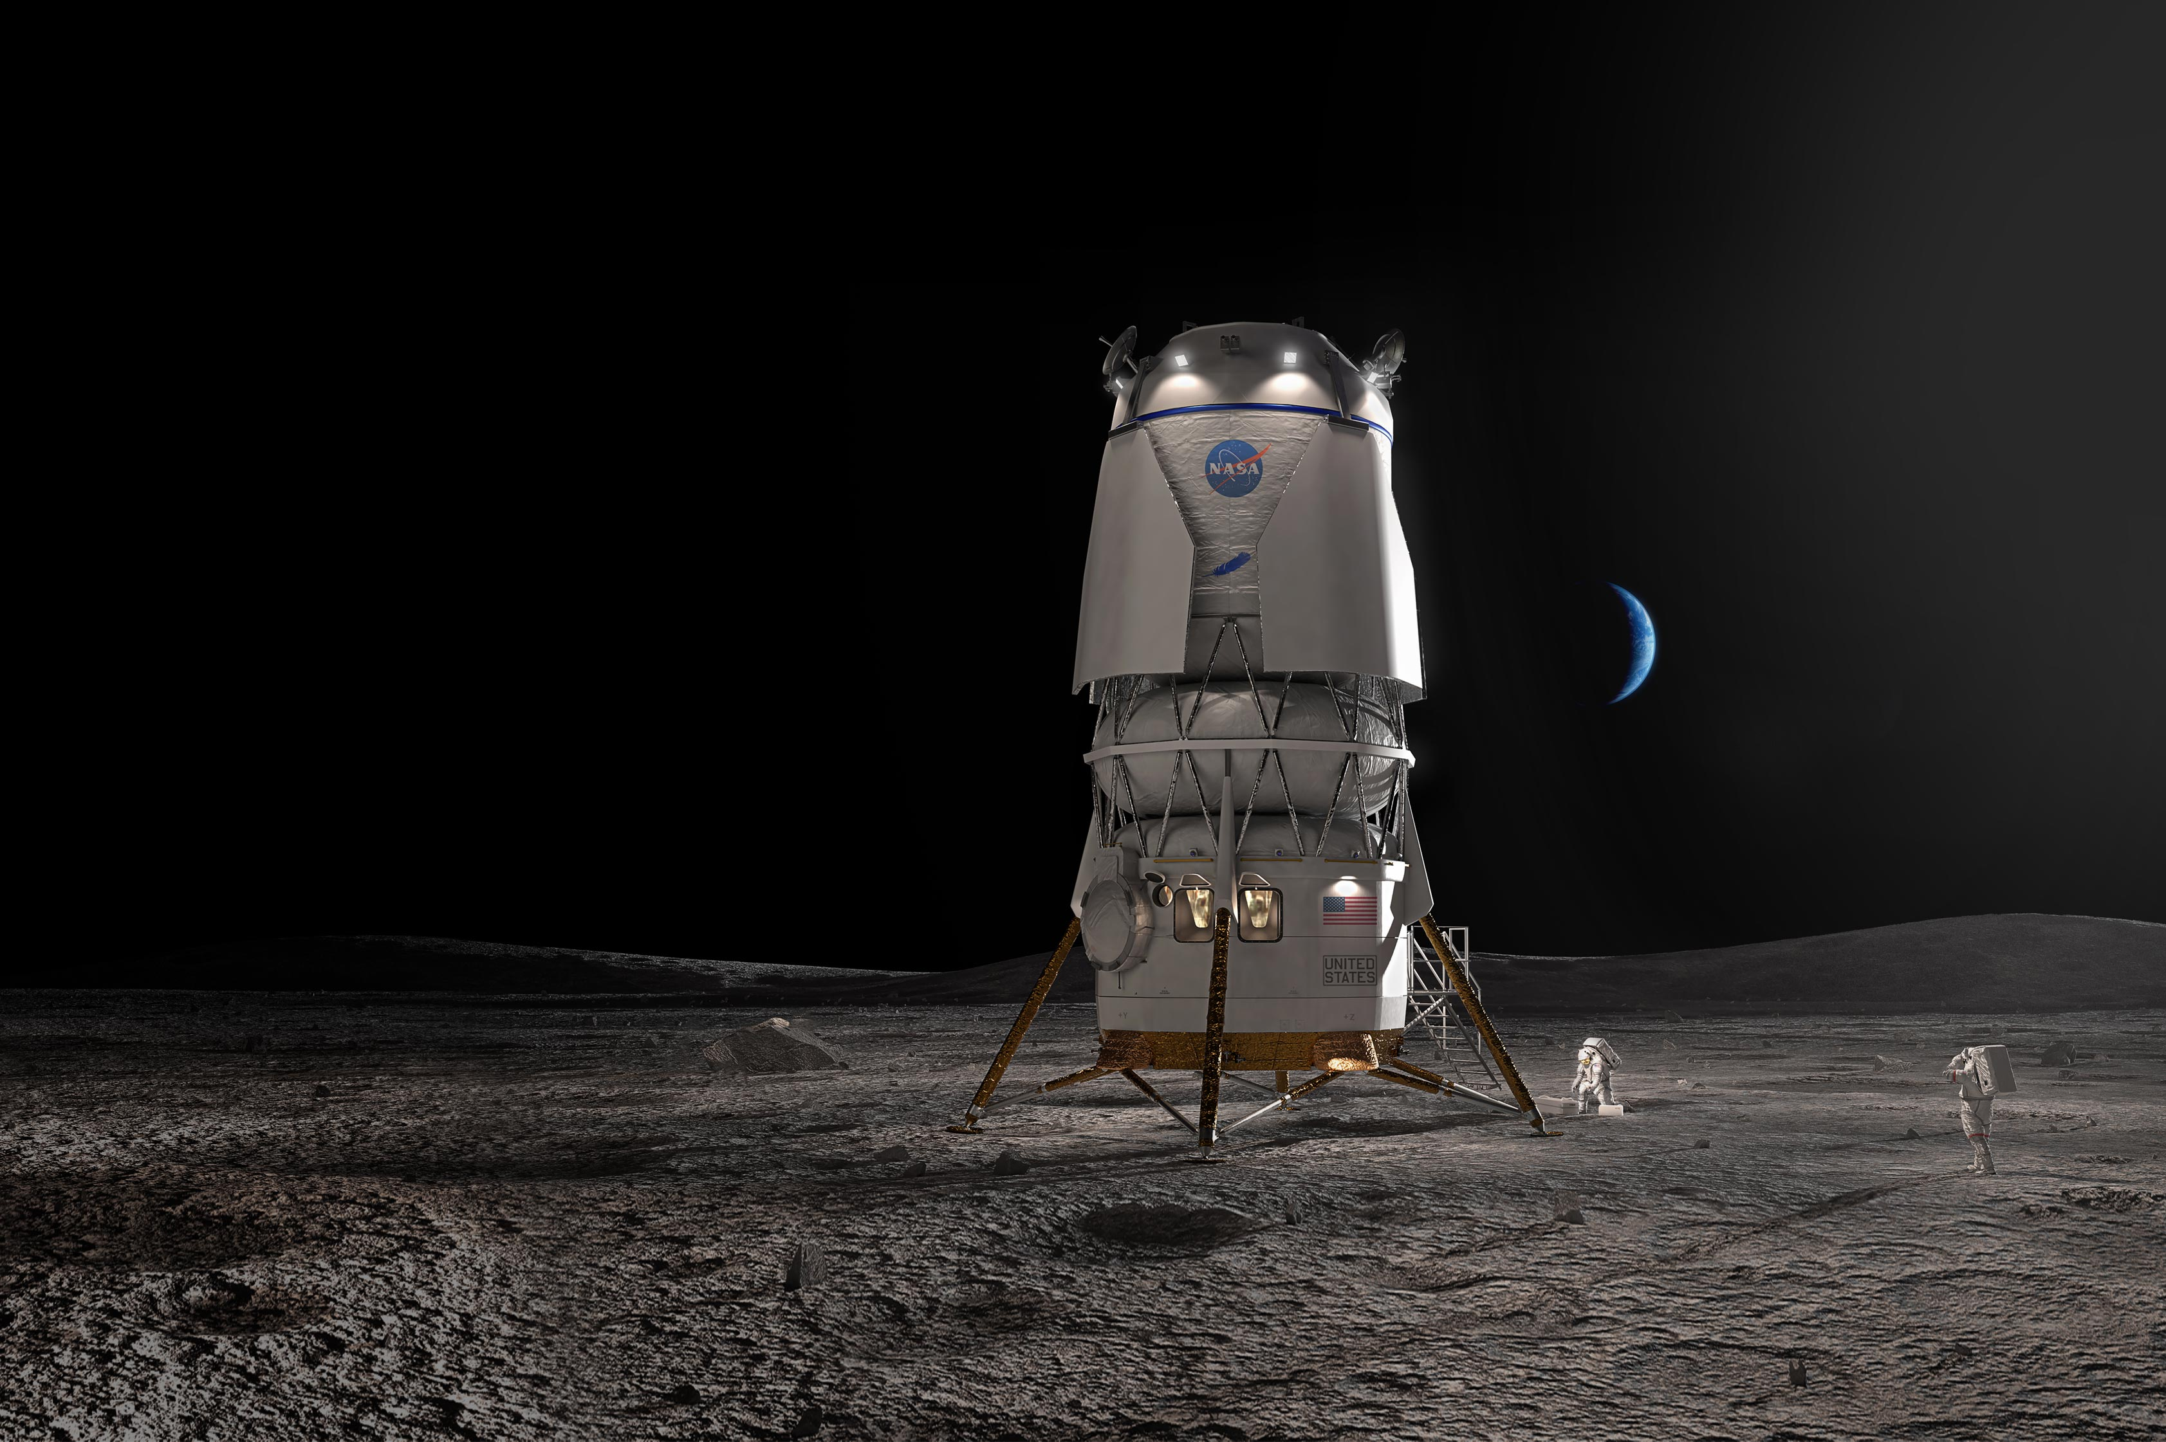
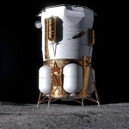
Lunar Lander Challenge
Introduction
Welcome to you, our future engineers!
Today you will be tackling a real-world engineering problem.
Your Mission: Design and build a lunar lander that can protect its “astronauts” during a simulated moon landing.
This activity will put your creativity, problem-solving, and teamwork skills to the test!

Slide 3
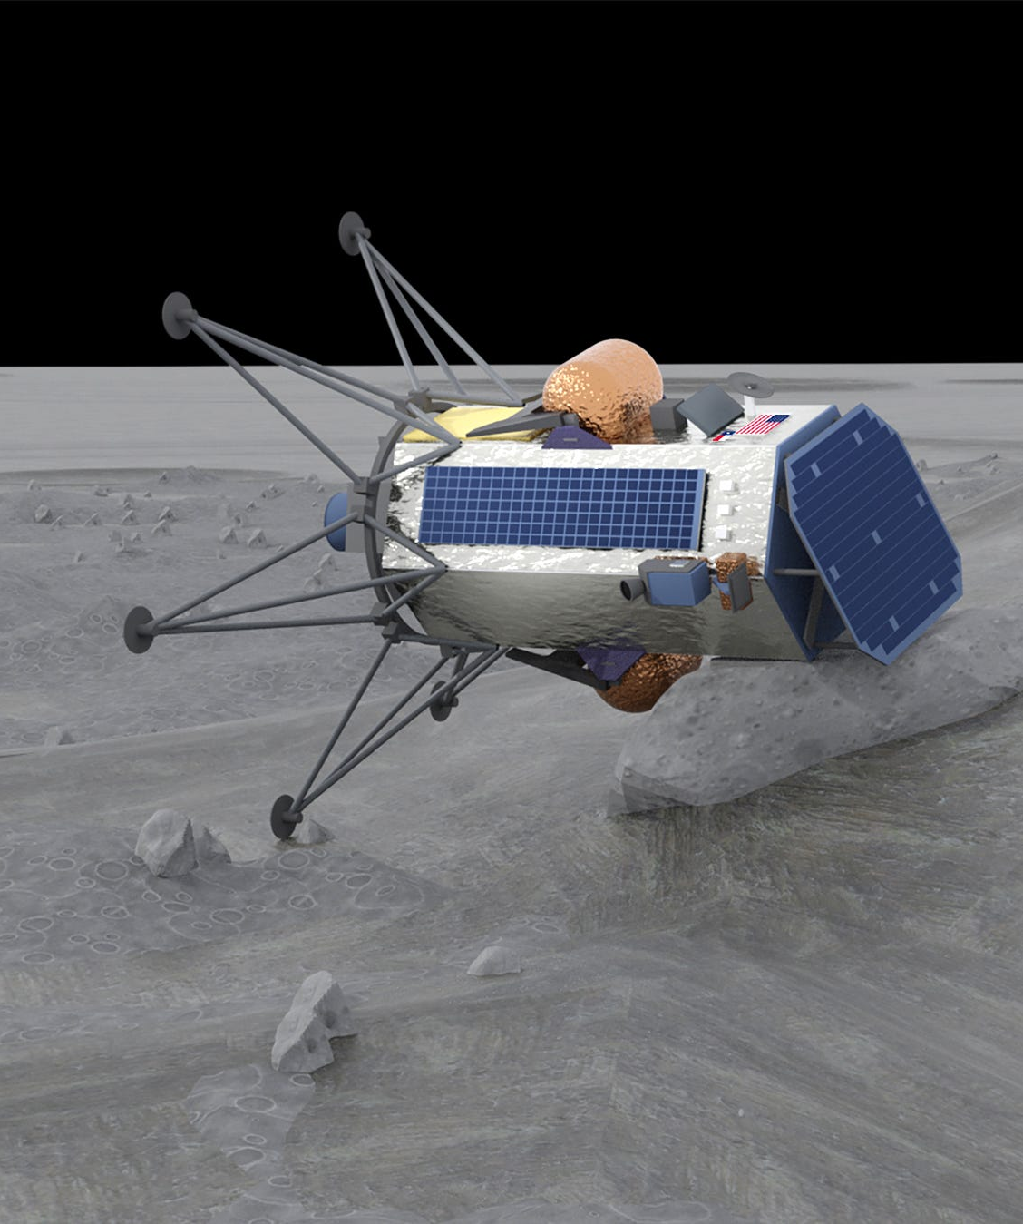
The Pitfalls of Landing
A Hard Landing
A Hard Landing
The Moon has no atmosphere to slow down a spacecraft (e.g. parachutes)
Landing typically requires precise control and a way to absorb impact
Delicate equipment and astronauts need to be protected from the force of impact

Slide 4
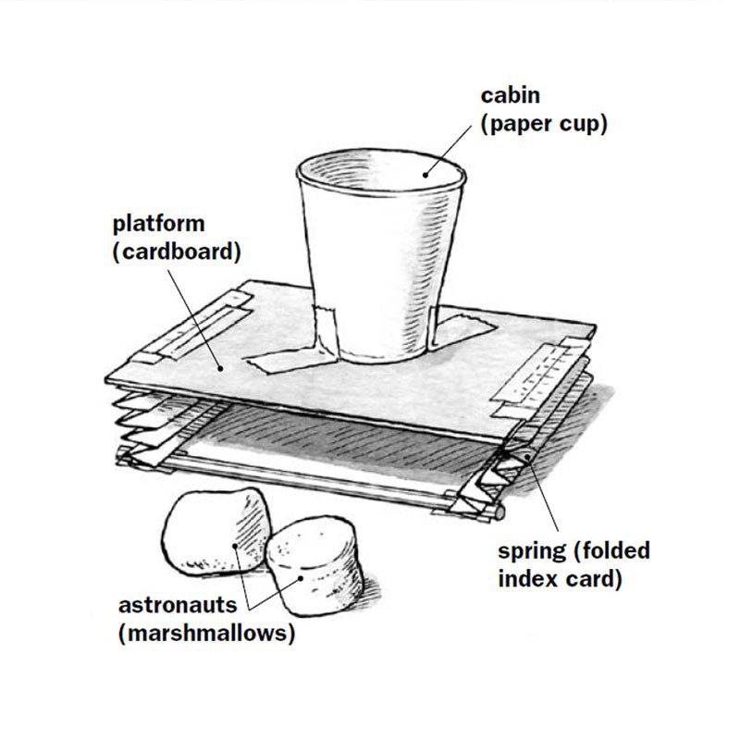
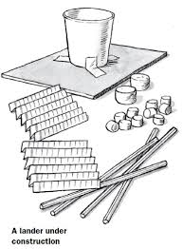
Requirements
Criteria for Success
The Goal: land your lander, starting from 1 foot, without the marshmallows from falling out
The “astronauts” need to stay within their landing capsule (i.e. the cup) without any lid, cage, or enclosure
The lander will land on the table

Slide 5
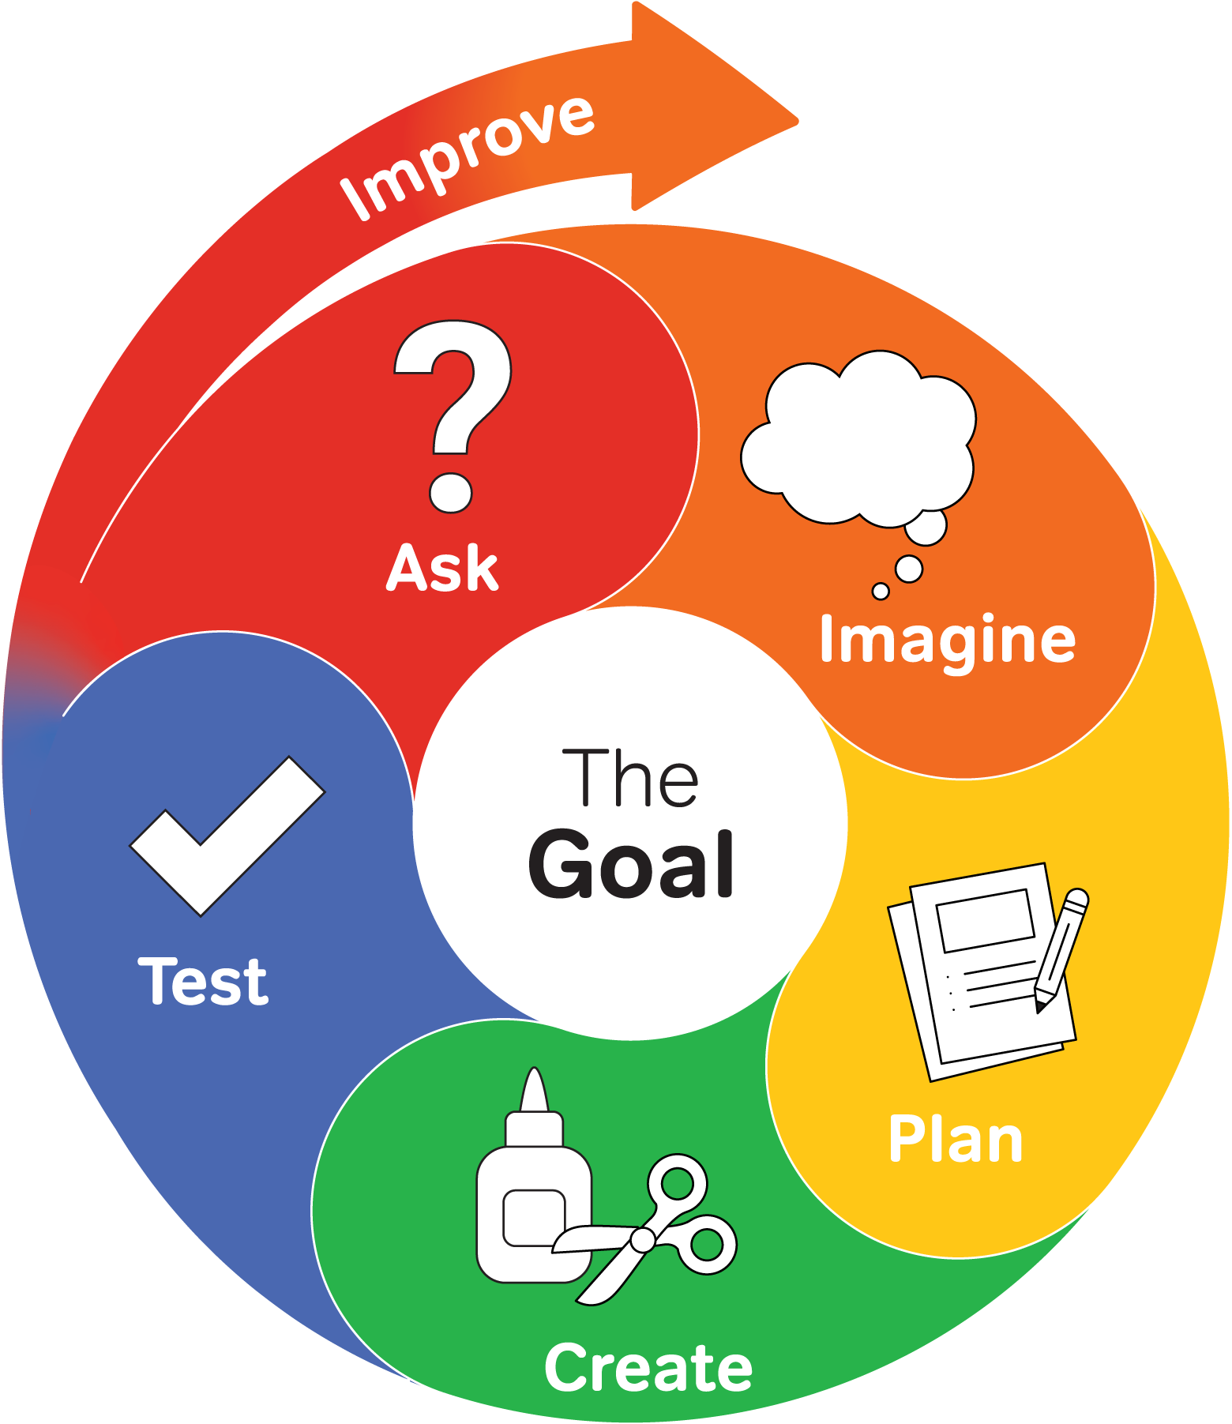
The Engineering Design Process
An Iterative Process to Engineering
Ask: What is the problem? What are the constraints?
Imagine: Brainstorm solutions! Draw concepts!
Plan: Choose your best ideas and create a more detailed drawing!
Create: Start building Version 1 of your prototype!
Test: Does it work? What happens when it lands?
Improve: What went wrong? How can you make it better?
Iterate: Implement design upgrades, fixes, or total rebuild based on what you learn!

Slide 6
Bill of Materials
Allowed Materials
Cup
Construction paper
Printer paper (unlimited)
Index cards
Popsicle sticks
Coffee stirrers
Flexible straws
Paper plates
Tape (unlimited)
Scissors

Slide 7
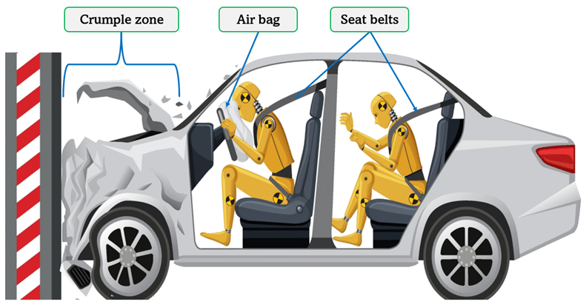

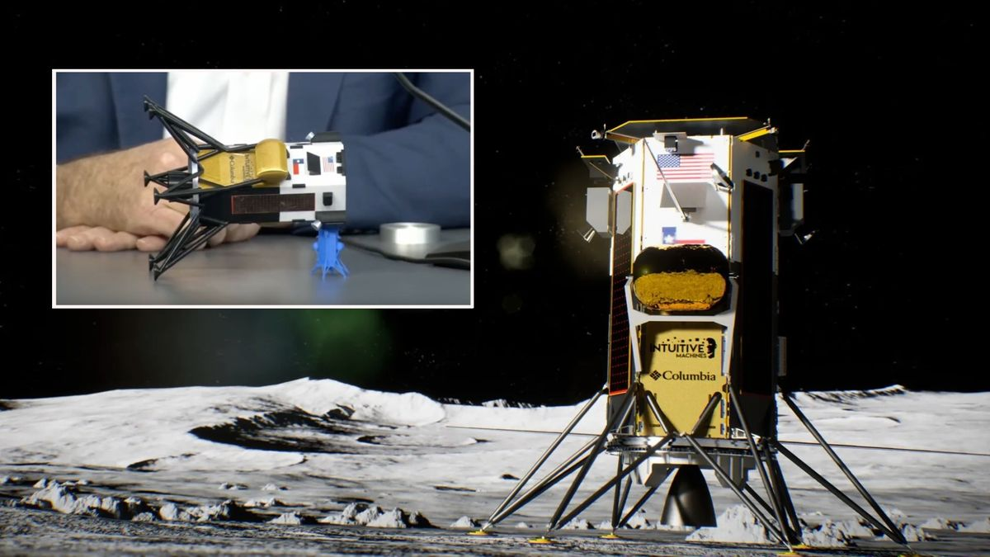
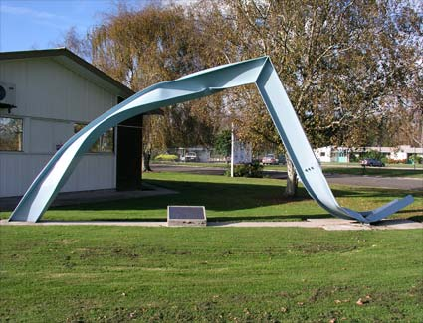
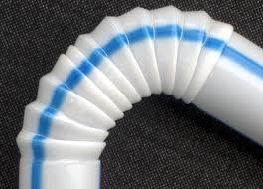
Design Considerations
Apply some Science!
Impact Absorption: How will you cushion the landing? (Springs, crumple zones, distributed force)
Stability: How can your lander stay upright? How many landing legs do you need?
Material Properties: What are the pros and cons of each material?

Slide 8
Challenge Rules and Constraints
Everyone plays Fairly!
Time Limit: You have 15 minutes to present your first prototype
Material Limit: You can use a reasonable amount of printer paper and tape, but otherwise you can only use the materials provided to your group.
“Astronaut” Safety: Your marshmallow “astronauts” must remain inside the lander and undamaged.
No lid, cage, or enclosure. “Astronauts” need to be unattached (not taped).
Drop Height: The first prototype will need to survive a minimum of 1-foot fall onto the table. Drop height will be increased if multiple teams accomplish this.
Corporate Espionage: You cannot “spy” on another team’s design.
Winning: The team that can survive the highest fall will win. Tiebreaker will be the team that uses the fewest types of materials.

Slide 9
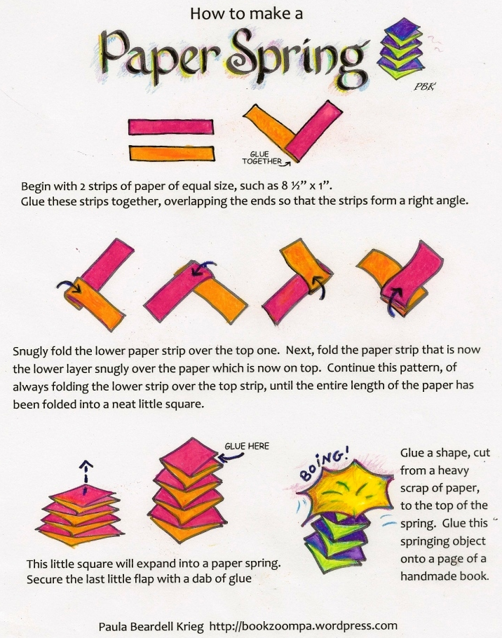
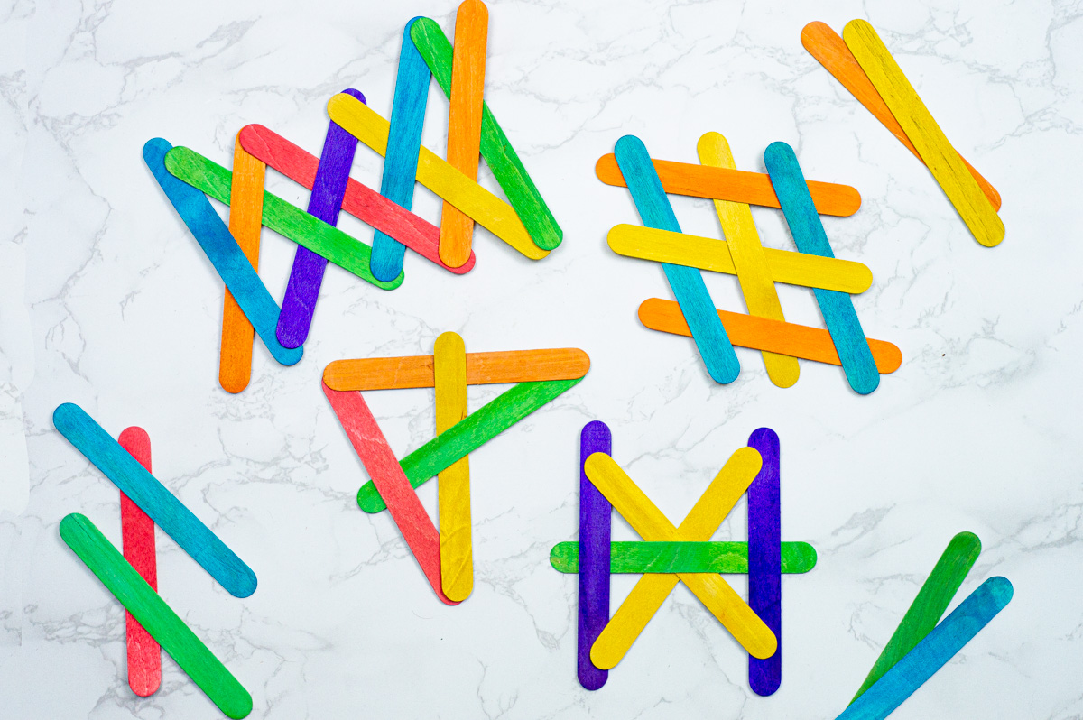
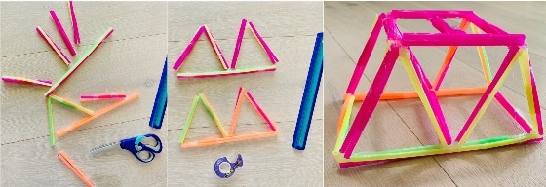
Plan Your Design!
Planning is half the battle
Brainstorm: Work with your team to generate as many ideas as possible, as quickly as possible!
Sketch: Draw out a concepts!
Discuss: Talk through the pros and cons of different approaches!
Select: Choose the best design for your first prototype to move forward with! Remember, you need to have a working prototype in 15 minutes!

Slide 10
Build Your Lander
You have 15 minutes from now to have a working prototype!

Slide 11
Build Your Lander
Tips
Work carefully and quickly
Remember the plan but be ready to quickly adapt if needed!
ABC: Always Be Communicating!
If you become stuck, try to help your teammate, switch to another task, or ask for help

Slide 12
Testing Your Design
Let It Drop!

Slide 13

Testing Your Design
Prototype test!
One by one, each team will test their lander
Observe: What happens during the landing?
Observe: Which design elements seem useful, and which seem unnecessary

Slide 14
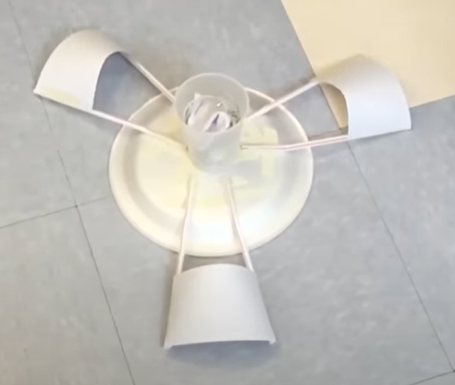
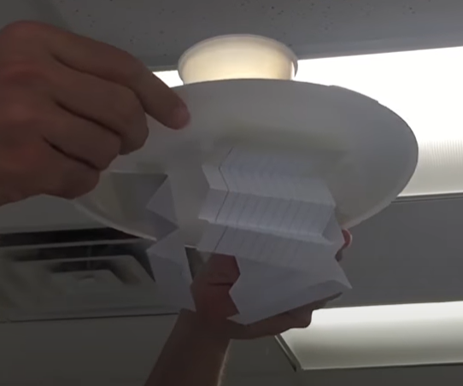
Iterate and Improve!
Prototype, version 2.0
Based on your test results, what can you improve?
Based on what you’ve seen from the other teams, what design changes should you make?
Go back to the drawing board if needed!
Make modifications
Re-test in 10 minutes!

Slide 15
Build your Lander, Part 2
You have 10 minutes to modify your design!

Slide 16
Re-Testing
Prototype Version 2.0 Testing
Each team will need to survive a re-test!
Observe: Did your modifications make any improvements?
Think: Knowing what you know now, would you have built your lander differently if you had to do it all over again?

Slide 17
That’s one small step for man, one giant leap for mankind
Neil Armstrong

